Slide 1



Python programming for the movement sciences
Marker-based python modules
Philippe C. Dixon^{1,2}, Jill Emmerzaal¹, Clint Hansen³, Robbin Romijnders³, Vaibhav Shah² ,
McGill University. Department of Kinesiology and Physical Education
University of Montreal. Biomedical Engineering Institute
Kiel University, Department of Neurology

Slide 2
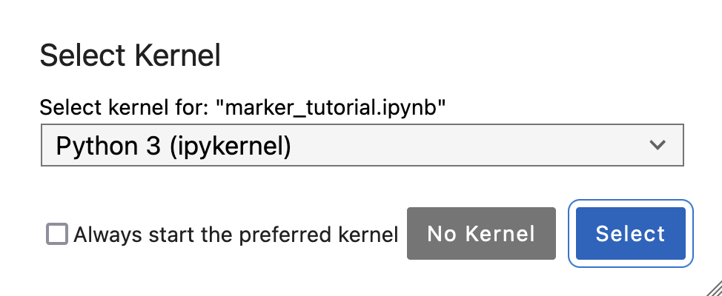
Marker-based python modules
Getting started
Associated Jupyter notebook can be found on the repo at ~/notebooks/marker-based toolboxes
Set environment before starting conda activate esmac-2024-seminar
When starting the notebook select correct kernel: “Python 3 (ipykernel)”

Slide 3
Marker-based python modules
Content
We will explore the following toolboxes/modules:
ezc3d: read/write c3d files (actually part of pyomeca...)
Pyomeca: biomechanical analysis toolbox
kineticstoolkit: (another) biomechanical analysis toolbox
This is only a start (and there are many more toolboxes out here)

Slide 4
Marker-based python modules
Reading/writing c3d files
Many motion capture systems export data to c3d format
The biomechanists needs an easy way to read (and maybe write) these files for further analysis
There are at least 3 python toolboxes to do this:
ezc3d
Pyomeca
kineticstoolkit

Slide 5
Marker-based python modules
Reading/writing c3d files
Pros/cons of different python modules for c3d data
Toolbox | Import command | Pros | Cons
ezc3d | c3d = ezc3d.c3d(c3d_file_path) | Simple import statement Fast reading | c3d object requires further parsing to access the data
kineticstoolkit | c3d= ktk.read_c3d(c3d_file_path, convert_point_unit=True) | Avoid installing ezc3d Part of a larger toolkit you might need anyway Data readily accessible | Extra argument “convert_point_unit” can be confusing Manipulates data
pyomeca | markers = Markers.from_c3d(c3d_file_path, prefix_delimiter=':') | Extra arguments “useful” | Loads markers, analog data separately

Slide 6
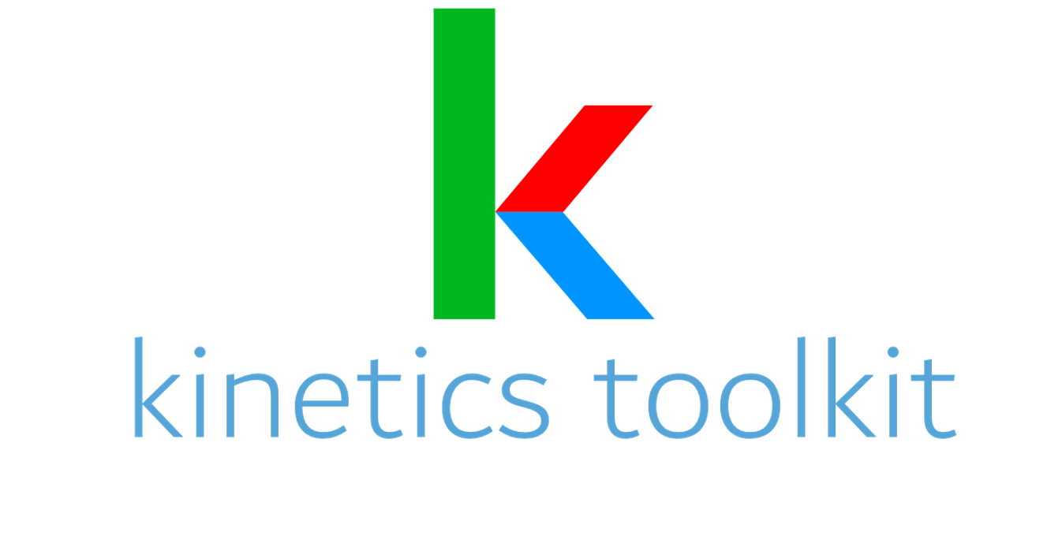
Marker-based python modules
Kineticstoolkit overview
With this beginner audience in mind, Kinetics Toolkit is a Python package for generic biome-
chanical analysis of human motion. It is a user-friendly tool for people with little experience
in programming, yet elegant, fun to use and still appealing to experienced programmers. De-
signed with a mainly procedural programming paradigm, its data processing functions can
be used directly as examples so that users can build their own scripts, functions, and even
modules, and therefore make Kinetics Toolkit fit their own specific needs
Multi-purpose toolbox for biomechanical analyses
Extensive tutorials, documentation, and exercises available: https://kineticstoolkit.uqam.ca/doc/
Backed by an open-source manuscript: https://joss.theoj.org/papers/10.21105/joss.03714
“With this beginner audience in mind, Kinetics Toolkit is …a user-friendly tool for people with little experience in programming… Designed with a mainly procedural programming paradigm, its data processing functions can be used directly as examples so that users can build their own scripts, functions, and even modules, and therefore make Kinetics Toolkit fit their own specific needs”

Slide 7
Marker-based python modules
Kineticstoolkit overview
With this beginner audience in mind, Kinetics Toolkit is a Python package for generic biome-
chanical analysis of human motion. It is a user-friendly tool for people with little experience
in programming, yet elegant, fun to use and still appealing to experienced programmers. De-
signed with a mainly procedural programming paradigm, its data processing functions can
be used directly as examples so that users can build their own scripts, functions, and even
modules, and therefore make Kinetics Toolkit fit their own specific needs
Features
Timeseries: a data “class” allowing for easy manipulation of standard biomechanical data
Data processing: basic tools to do all kinds of biomechy things
Visualization: see what you’ve done! An integrated player to help you visualize data

Slide 8
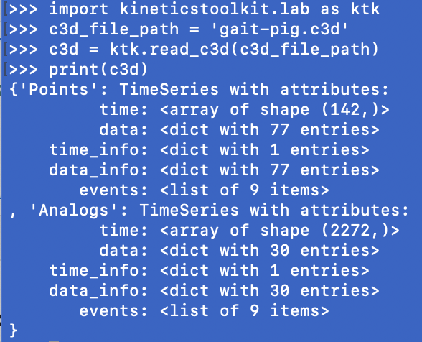
Marker-based python modules
Kineticstoolkit timeseries
With this beginner audience in mind, Kinetics Toolkit is a Python package for generic biome-
chanical analysis of human motion. It is a user-friendly tool for people with little experience
in programming, yet elegant, fun to use and still appealing to experienced programmers. De-
signed with a mainly procedural programming paradigm, its data processing functions can
be used directly as examples so that users can build their own scripts, functions, and even
modules, and therefore make Kinetics Toolkit fit their own specific needs
We often process data that is function of time (e.g., electromyography, marker trajectories)
Numpy can only take us so far
Kineticstoolkit provides a new type of variable called the timeseries
Every TimeSeries contains time, data, events and metadata (”data_info”).

Slide 9
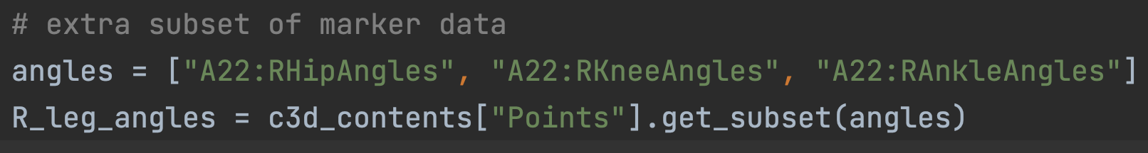
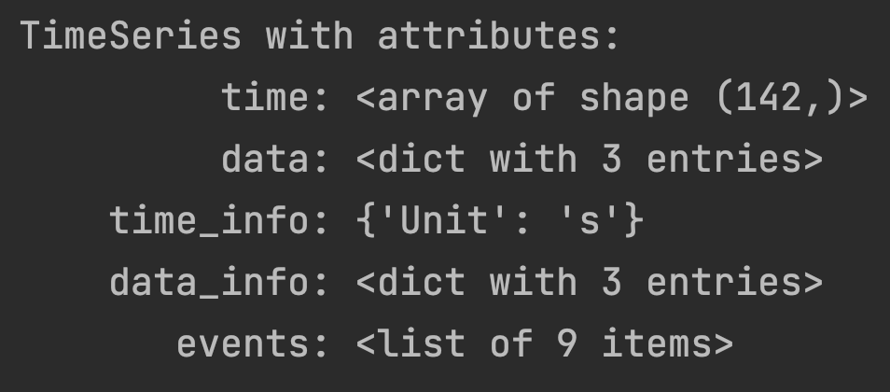
Marker-based python modules
Kineticstoolkit timeseries
With this beginner audience in mind, Kinetics Toolkit is a Python package for generic biome-
chanical analysis of human motion. It is a user-friendly tool for people with little experience
in programming, yet elegant, fun to use and still appealing to experienced programmers. De-
signed with a mainly procedural programming paradigm, its data processing functions can
be used directly as examples so that users can build their own scripts, functions, and even
modules, and therefore make Kinetics Toolkit fit their own specific needs
A closer look at some timeseries data
3 entries since we asked for 3 angles

Slide 10
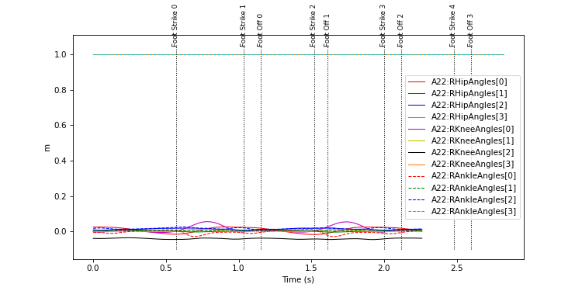
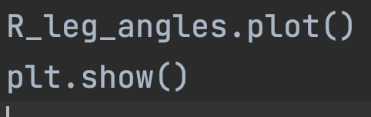
Marker-based python modules
Kineticstoolkit timeseries
With this beginner audience in mind, Kinetics Toolkit is a Python package for generic biome-
chanical analysis of human motion. It is a user-friendly tool for people with little experience
in programming, yet elegant, fun to use and still appealing to experienced programmers. De-
signed with a mainly procedural programming paradigm, its data processing functions can
be used directly as examples so that users can build their own scripts, functions, and even
modules, and therefore make Kinetics Toolkit fit their own specific needs
Plot them!
R_leg_angles is an instance of the timeseries class
Plot is a method of the timeseries class
Not the nicest figure out of the box, but user can clean it up

Slide 11
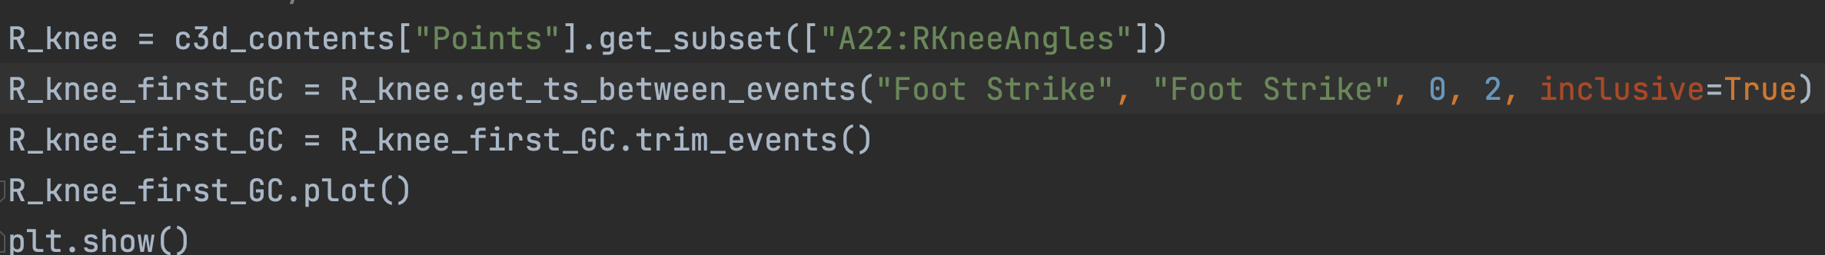
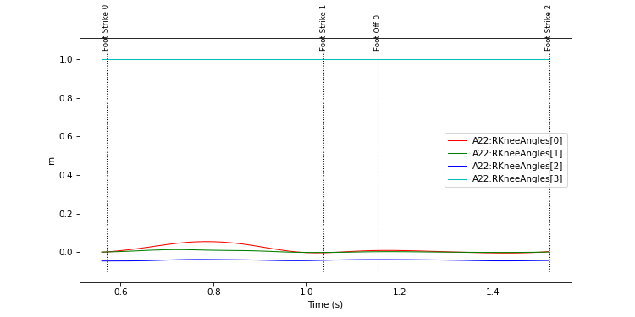
Marker-based python modules
Kineticstoolkit timeseries
With this beginner audience in mind, Kinetics Toolkit is a Python package for generic biome-
chanical analysis of human motion. It is a user-friendly tool for people with little experience
in programming, yet elegant, fun to use and still appealing to experienced programmers. De-
signed with a mainly procedural programming paradigm, its data processing functions can
be used directly as examples so that users can build their own scripts, functions, and even
modules, and therefore make Kinetics Toolkit fit their own specific needs
Plot them! (a little nicer)

Slide 12
Marker-based python modules
Kineticstoolkit Data processing
Basic biomechanical processing functions included:
Filtering
Cycle detection and time-normalization
Geometry
Rigid body kinematics

Slide 13
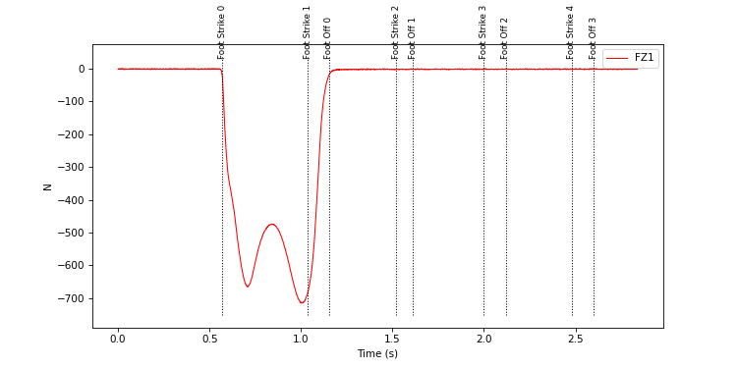
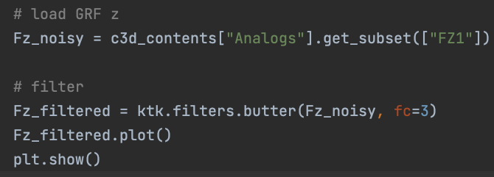
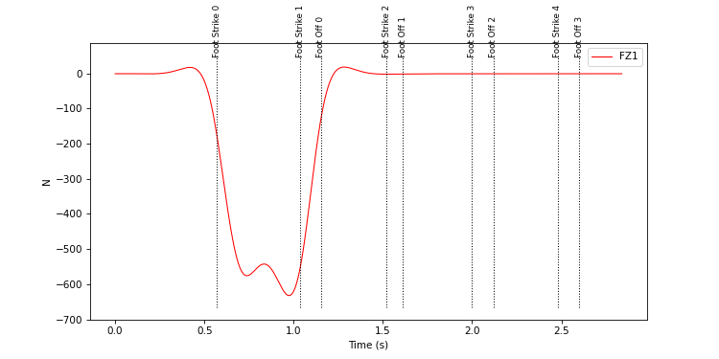
Marker-based python modules
Kineticstoolkit Data processing
Filtering data
Ridiculous cutoff frequency to show effect
Raw (top) and filtered (bottom) vertical ground reaction force (Fz)

Slide 14
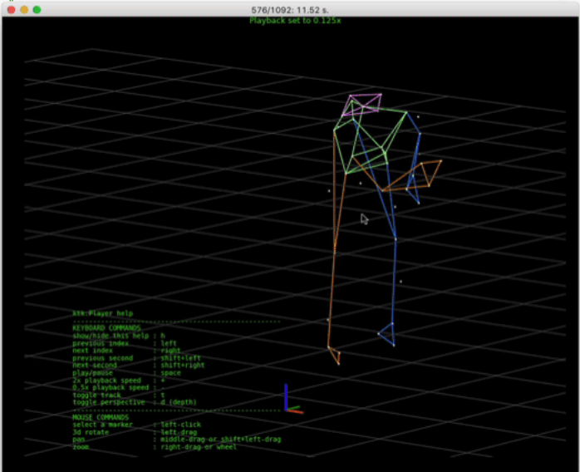
Marker-based python modules
Kineticstoolkit Visualization
Probably the coolest feature of ktk is visualization via player:
Interactive Matplotlib-based user interface to visualize points and frames in three dimensions
Can be customized to the user’s needs
Available in notebooks and IDEs
Ktk player

Slide 15
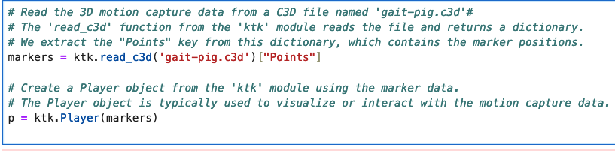
Marker-based python modules
Kineticstoolkit Visualization
See player class for all possible arguments to customize views

Slide 16
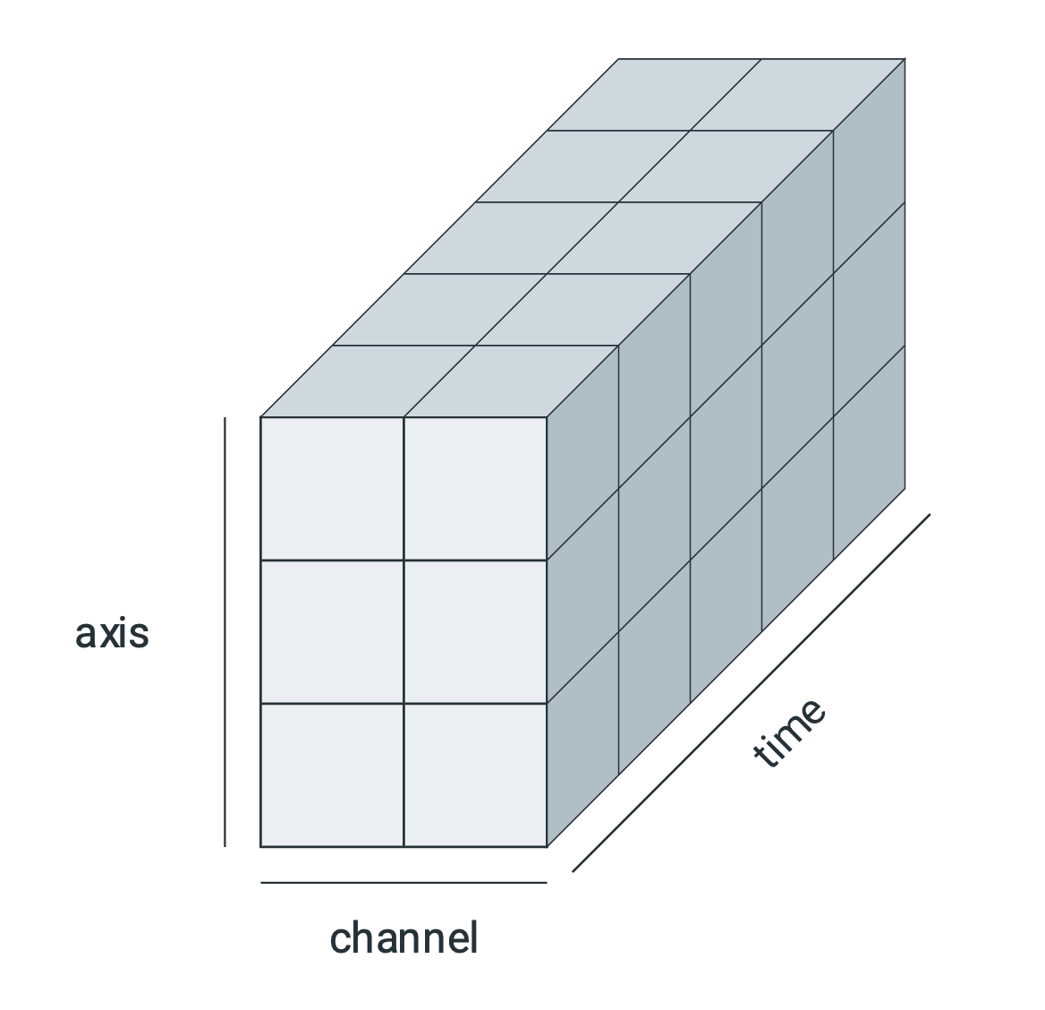
Marker-based python modules
Pyomeca overview
From the creators:
- “Pyomeca introduces a concise interface to read, analyse, visualize and plot biomechanical data”
- Such data are typically multi-dimensional, such as joint angles with associated axes, degrees of freedom and time frames.
Typical structure for biomechanical data

Slide 17
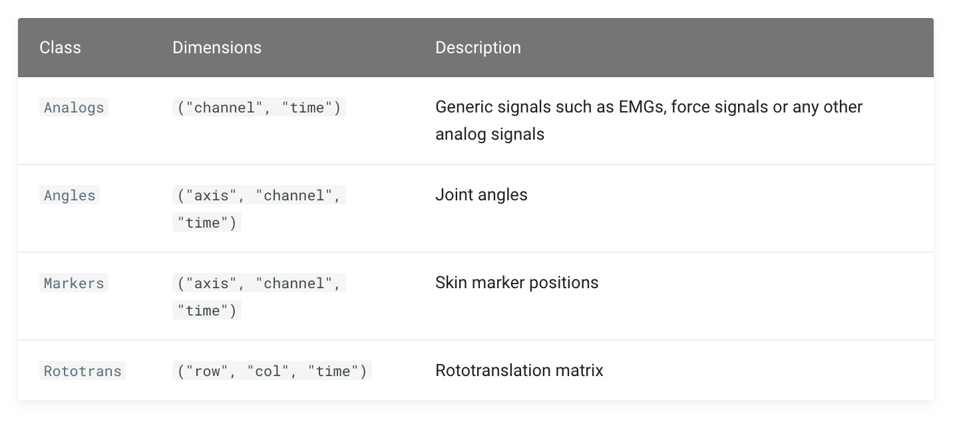
Marker-based python modules
Pyomeca main functionalities (classes)

Slide 18
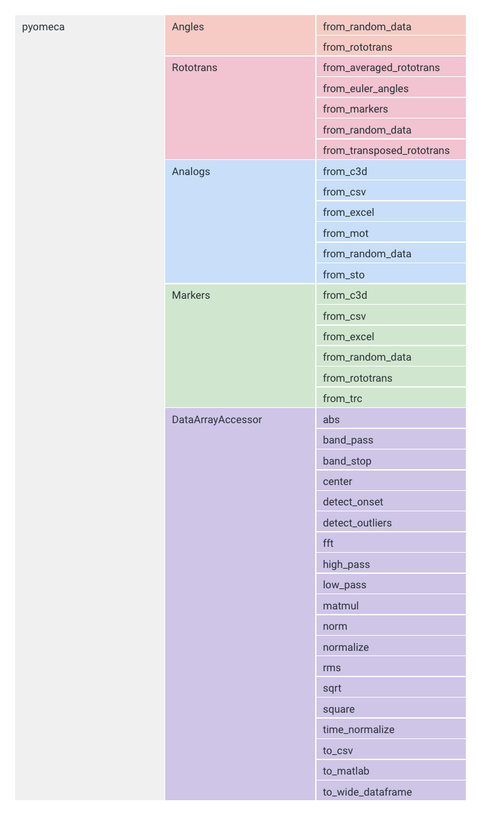
Marker-based python modules
Pyomeca main functionalities (classes)
Interactive visualization of main functionalities available on line: https://pyomeca.github.io/overview/

Slide 19
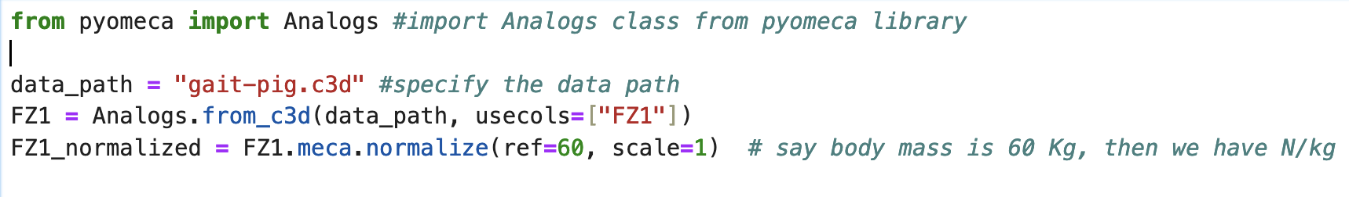
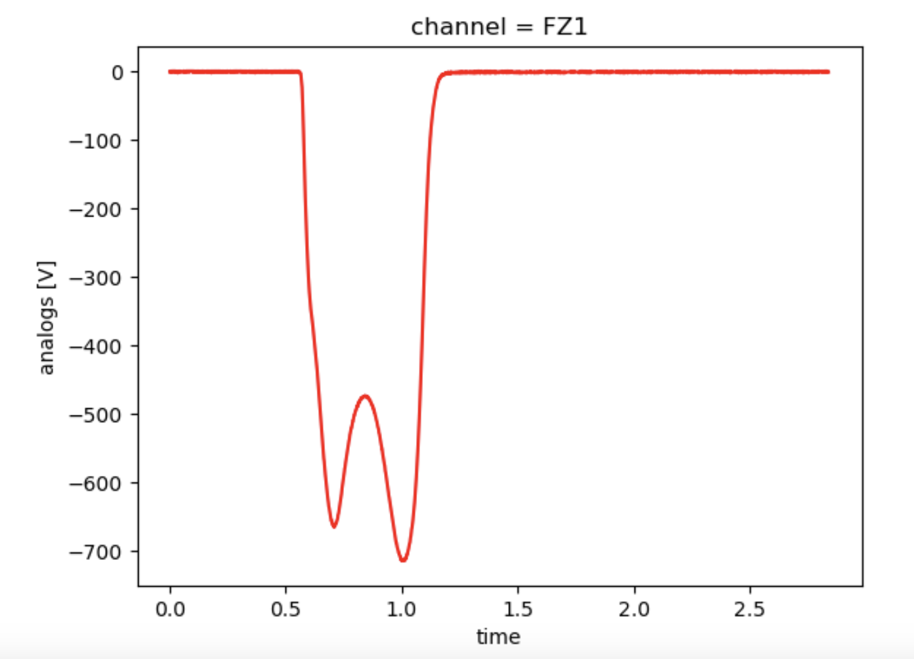
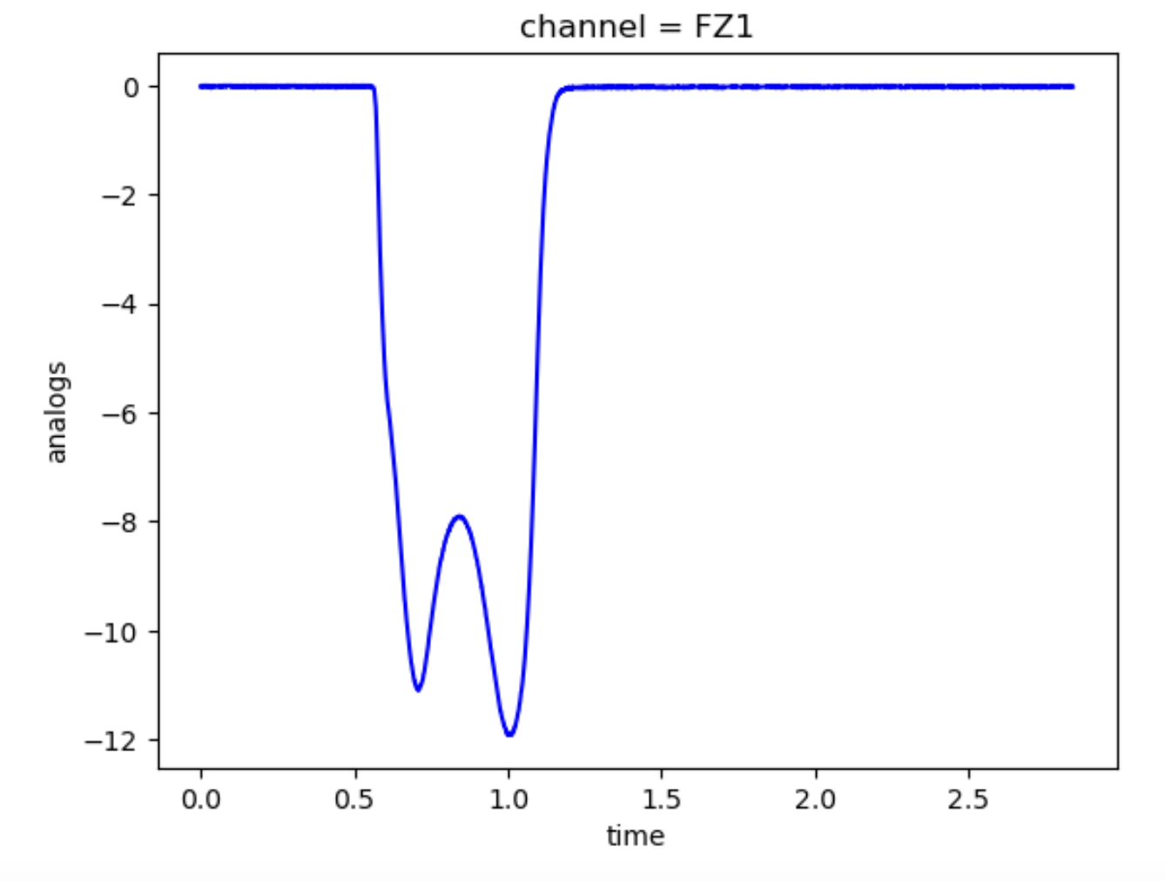
Marker-based python modules
Pyomeca: Data Array accessor
Normalize amplitude example

Slide 20
Marker-based python modules
Module comparison/summary
Summary:
ezc3d is a solid tool to import c3d files
Kineticstoolkit is easier for the beginner user
Pyomeca useful for hard core data manipulations (e.g. rotational matrices), but scary under the hood
What we (I) suggest:
Use ezc3d for basic import
Build and reuse your own lab scripts to access markers/analog data
Pick a toolbox (kineticstoolkit/pyomeca) and master it.
If you need new functionalities develop them and contribute back to the community by updating your toolbox of choice

Slide 21
Overview of content so far
Ezc3d is awesome for loading c3d files
Kineticstoolkit for beginners
Pyomeca for advanced data manipulations

